Slide 1
Bias and Variance K fold VS LOO Bootstrap steps

Slide 2

Bias
bias as the error between average model prediction and the ground truth.
A model with a higher bias would not match the data set closely.
A low bias model will closely match the training data set.
Characteristics of a high bias model include:
Failure to capture proper data trends
Potential towards underfitting
More generalized/overly simplified
High error rate

Slide 3
Variance
changes in the model when using different portions of the training data set
the expected value of the square of the difference between predicted values and the expected value of the predicted values.
Variance = E[(Y’ - E[Y’])^2], where Y is ground truth and Y’ is predicted value E[Y’] is the estimated value of predicted value.
Low variance:
model is less sensitive to changes in the training data
High variance:
model is very sensitive to changes in the training data, overfitting

Slide 4
Different Combinations of Bias-Variance
High Bias, Low Variance:
A model with high bias and low variance is said to be underfitting.
High Variance, Low Bias:
A model with high variance and low bias is said to be overfitting.
High-Bias, High-Variance:
model is not able to capture the underlying patterns in the data (high bias)
too sensitive to changes in the training data (high variance)
Low Bias, Low Variance:
able to capture the underlying patterns in the data (low bias)
not too sensitive to changes in the training data (low variance)

Slide 5
Ways to Low Bias, Low Variance
Low Bias: Increase Complexity from capacity
Low Variance
Cross-validation: By splitting the data into training and testing sets multiple times
Feature selection: By choosing the only relevant feature
Regularization: We can use L1 or L2 regularization to reduce variance in machine learning models
Ensemble methods: It will combine multiple models to improve generalization
Bagging, boosting, and stacking
Simplifying the model: Reducing the complexity of the model, such as decreasing the number of parameters or layers in a neural network
Early stopping: Early stopping is a technique used to prevent overfitting by stopping the training of the deep learning model when the performance on the validation set stops improving.

Slide 6
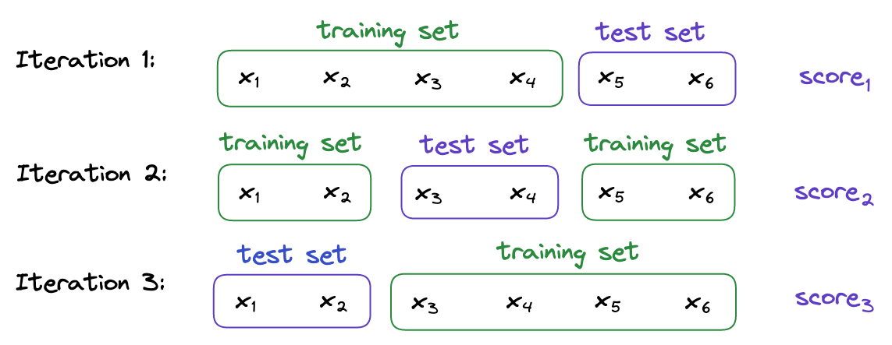
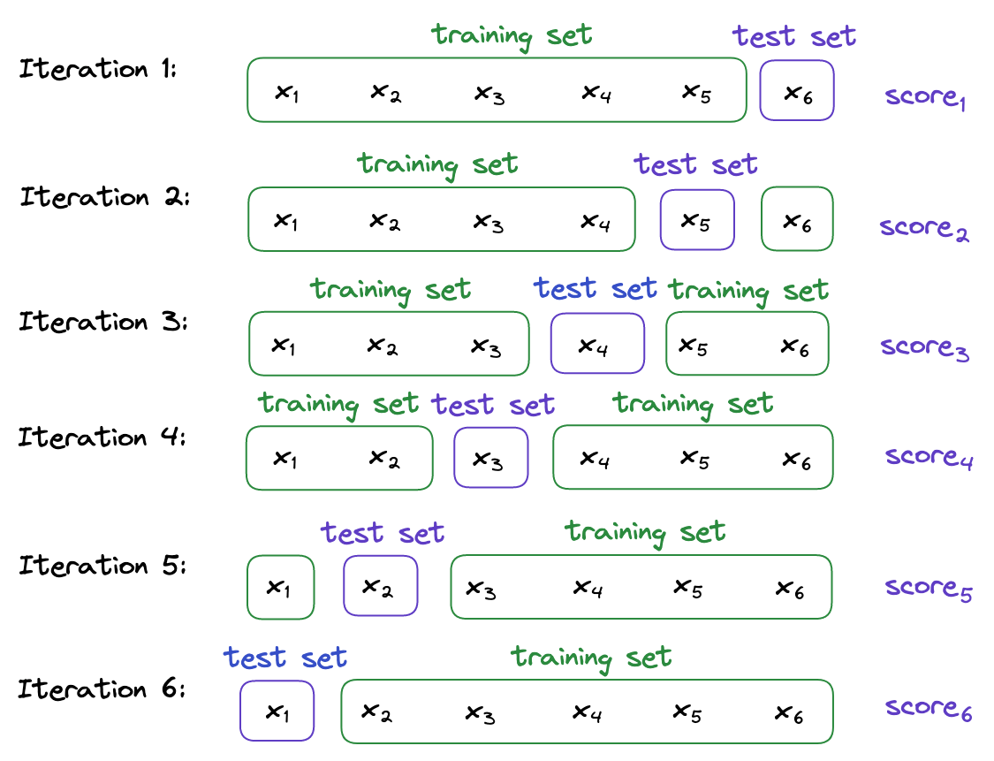
K fold vs LOO

Slide 7
Bootstrap Validation steps
Develop prediction model in the original data => Apparent Performance
Generate a bootstrap sample.
Develop a model using the bootstrap sample, determining the apparent performance of the model on the bootstrap sample and the test performance of the bootstrap model in the original sample.
Calculate the optimism as the difference between the bootstrap performance and test performance
Repeat steps 2 through 4, n times.
Average the estimates of optimism in step 5, and subtract the value from the apparent performance obtained in step 1 to obtain the optimism-corrected estimate of performance.

